Slide 1
Sisterhood of Salaam Shalom
2020 Sadaqah/Tzedakah Project
We can raise awareness and brighten the lives of children, families, and adults seeking asylum.

Slide 2
Overview: Sadaqah/Tzedakah Day 2020
One of the Sisterhood of Salaam Shalom’s signature endeavors, Sadaqah/Tzedakah Day, occurs annually around the Christmas season. In Islam, Sadaqah is voluntary charity and a virtuous deed. In Judaism, Tzedakah derives from the Hebrew root tz/d/k and literally means “justice.”
As a suggested project for Sadaqah/Tzedakah Day 2020, the Sisterhood’s Immigrant Communities Advocacy and Support (ICAS) Social Justice Action Group* is partnering with Lutheran Immigration and Refugee Service (LIRS) in their Hope for the Holidays project, which will raise awareness of and brighten the lives of adults, children, and families who are seeking asylum and impacted by the immigration detention system.
This project offers four key ways for all Sisterhood members to get involved:
Create greeting cards and write messages of hope to asylum seekers and refugees.
Donate to help purchase gifts for children currently in detention.
Advocate through signing LIRS’ “End the Detention of Families and Children” petition.
Educate yourself to become a better advocate for immigrants and asylum seekers in the U.S.
Read on for details!
*ICAS works to alleviate and prevent injustices that impact immigrant communities by engaging the Sisterhood in advocacy, education, and assistance initiatives.

Slide 3
A Service, Learning, and Advocacy Initiative
What’s in this toolkit?
Ways You Can Participate:
Create or buy cards of hope and encouragement for the adults and children in detention*…….Slides 4-5
Donate so that every detained child receives a special gift………………………………………….Slide 6
Advocate for children and families in detention centers……………………………………………..Slide 7
Educate yourself and others about immigration detention…………………………………………...Slides 8-9
Additional Ways to Assist, Learn, and Take Action……………………………………...………..Slides 10-11
Project Survey…………………………………………………………………………………………….Slide 12
*Cards must be mailed to LIRS no later than Dec. 4th
💜 Your safety is of the utmost importance. Please do not shop or go to the post office if it’s not medically safe for you to do so. This project offers several options for participating that don’t involve going out.
💜 Please read through all the slides to make sure you have everything you need before you begin.

Slide 4
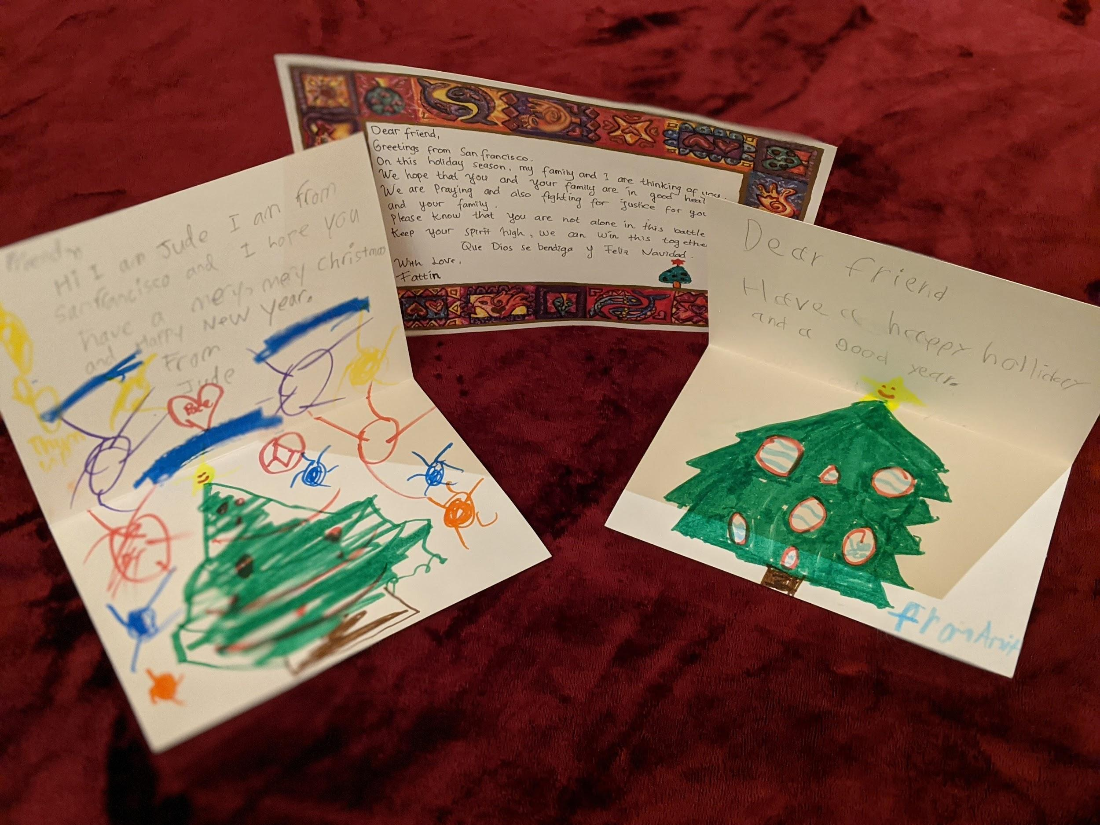
Assist: Create Cards
Design a card and include messages of hope and encouragement in English and Spanish (or Arabic, French, or Chinese).
If you are writing in a language other than English or Spanish, please rubber band those cards together and enclose a note listing the languages in which the cards are written.
Sign only your first name and city/state.
Place all your cards into one large envelope (NOT individual envelopes). Please click on the link to download the Holiday Card Cover Sheet and enclose it with your cards.
Do not use any glitter or jeweled stickers, as these can be choking hazards. Decorate using any medium that is suitable for young children.
Mail your cards by December 4th so that LIRS can distribute them before the holidays. After Dec. 4th, please send cards with general messages of hope and encouragement to LIRS ATTN: Whitney Palmer 700 Light Street, Baltimore, MD 21218.
Optional: Use the following link to download a Sisterhood of Salaam Shalom logo to include on your card.
Mail your cards with the cover sheet to:
First English Evangelical Church
Attention Hope for the Holiday
3807 North Charles Street, Baltimore, MD 21218

Slide 5
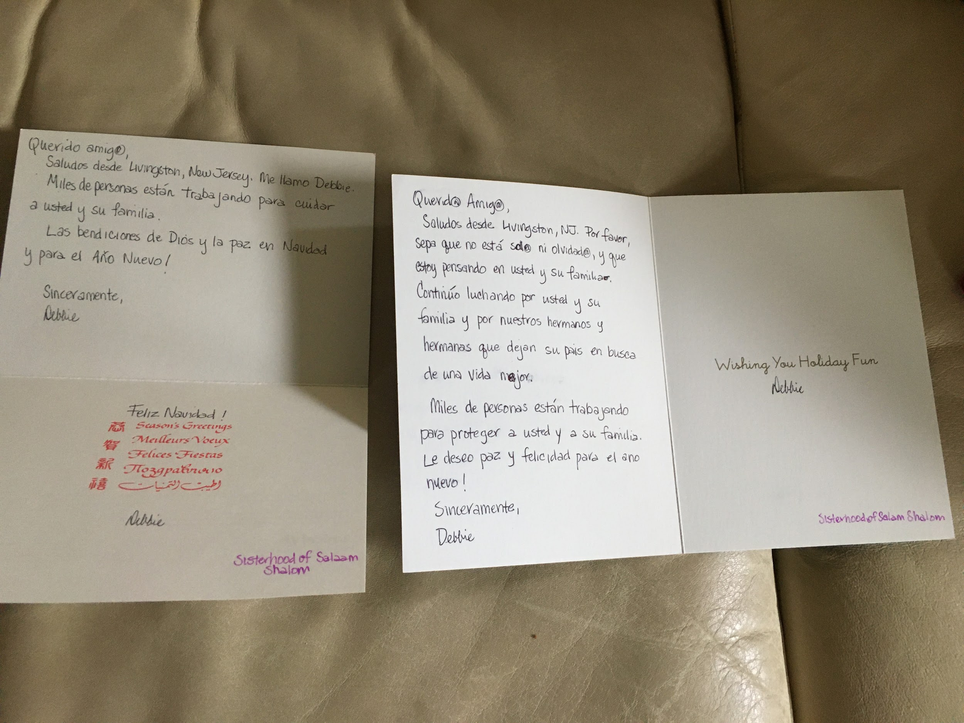
Sample Greetings in English and Spanish
Dear Friend,
Greetings! Please know that I am thinking about you and your family. I am also fighting for justice for you and your family as you left your
home in search of a better life. I want you to know that many people
are working to keep you and your family safe. I wish you peace and
happiness for the new year!
Sincerely,
First name only; City/state
* * * * * *
Querido (male)/Querida (female) Amigo/Amiga,
Saludos! Por favor, sepa que estoy pensando en usted y su familia.
Continúo luchando por usted y su familia que dejan su país en
busca de una vida mejor. Miles de personas están
trabajando para proteger a usted y a su familia.
Le deseo paz y felicidad para el año nuevo!
Sinceramente,
First name only; City/State
Other phrases:
May G-d bless you! -- Que Dios se bendigo!
Merry Christmas!-- ¡Feliz Navidad!
Happy New Year! -- ¡Feliz Año Nuevo!
Please take photos!
Sharing our activities will help all of us keep those in detention in our minds and will raise continued awareness of the challenges facing asylum seekers. If you have a card making party with others, take a photo of your session, with permission, and post it to your Facebook timeline. Be sure to tag the Sisterhood’s Facebook page!

Slide 6
Assist: Donate to Purchase Gifts for Children
Make a Donation to Lutheran Immigration and Refugee Service
With your donations, Lutheran Immigration and Refugee Service (LIRS) will purchase gifts for children who are currently in detention.They will deliver them in time to be opened on Christmas morning.
Imagine the joy that you could bring to these children!
Thank you for helping LIRS provide “Hope For the Holidays” to these kids.
Donate here

Slide 7
Advocate: For Children and Families
As Muslim and Jewish women guided by our faith and the principles of justice for all, we are compelled to advocate for those seeking asylum and to speak out against the deeply troubling practices facing asylum seekers. These children and families already suffer from psychological trauma resulting from the circumstances that caused them to flee their countries. As a direct result of our government’s inhumane policies, which violate existing U.S. and international laws, they will now carry additional trauma for the rest of their lives.
Join us by signing and circulating LIRS’s “End the Detention of Families and Children” petition. It calls for an end to family separations, the release of currently detained children and families, and for current policy to follow existing laws that prescribe special protections for children. The petition will be sent to Congressional leadership and the President after the holidays.
https://www.votervoice.net/LIRS/Petitions/2452/Respond Please click this link to view and sign the petition, and then share the link with your family and friends.

Slide 8
Educate: Key Facts About Seeking Asylum
A growing number of unaccompanied children from Central America, many fleeing gang violence, trafficking, extortion, abuse, and poverty, seek asylum in the U.S.
Under the Department of Justice’s “Zero Tolerance” policy, thousands of family separations occurred. 20% of those separated were under the age of five. 666 children have yet to be reunited with their parents.
Seeking asylum has increasingly become a criminalized process. Since 2014, family detention has increased by 4000%. The majority of individuals apprehended by Customs Border and Patrol (CBP) or Immigration and Customs Enforcement (ICE) along the Southern Border are placed in one of ICE’s 200 jails and detention centers while awaiting immigration proceedings.
Due to a lack of PPE, nonexistent social distancing, and inadequate medical attention and Covid testing, COVID-19 puts the lives of people in detention centers in grave danger.

Slide 9
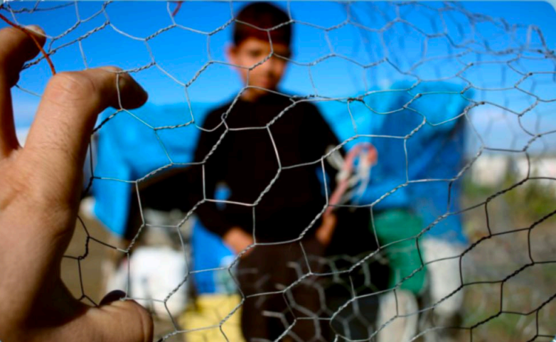
Meet Carlos from Central America
One Sunday morning, despite his mother’s fears, Carlos went to church. But even church was not a safe haven. Gang members shot at Carlos because he had refused to join their gang. Carlos was only in 7th grade, but he decided to leave his family and the only home he had known in order to escape the gangs. After 12 days of arduous travel, he arrived at the U.S. Southern border full of hope.
Carlos’s story is just one example of the risks so many children, families and adults take to flee danger and persecution. No mother should have to send her child on a dangerous journey in order for that child to have a chance to live in safety, full well knowing she might never see her child again. No child should have to endure the trauma of leaving everyone and everything familiar and known to travel alone to a strange country and face an uncertain fate.
By partnering with LIRS on this Sadaqah/Tzedakah holiday initiative, we will bring joy
to children, who, like Carlos, come to the U.S. hoping for a better future.

Slide 10
Additional Ways To Get Involved
HIAS:
Donate Airline Miles: To donate miles to asylum-seekers and refugees: https://www.miles4migrants.org/hias/
Donate Uber Gift Cards for Transportation Needs: Please purchase a gift card on Uber’s website and email the digital gift card to inkinddonations@hias.org. (Please make sure to indicate in the message if you would like a tax-exempt receipt.)
For more information or to make a monetary donation: https://www.hias.org/
CAIR Coalition: The Capital Area Immigrants’ Rights Coalition*
*Not to be confused with CAIR - the Council on Islamic-American Relations
Purchase D.C. Metro cards or gift cards to Walmart, Target, Giant and Safeway. Please enclose a note indicating that you are with the Sisterhood of Salaam Shalom.
Send gift cards to: Claire Gillooly Dempsey, 3173 18th St. NW, Washington, DC 20010
For more information or to make a monetary donation: https://www.caircoalition.org
Families at the Border Wish Lists: http://med.stanford.edu/pedsadvocacy/engagement/FATB.html
Refugee Health Alliance (provides healthcare to folks in Tijuana): Use the Vincent Cannalla’s address to ship.
Pedagogical Inst of LA (runs child learning center in Tijuana and globally): Use Nest/Sheri Easterly’s Address to ship.
For more information or to make a monetary donation: https://my.supportlpch.org/fundraiser/2510287

Slide 11
Additional Resources for Learning and Action Steps
To learn more, explore these links:
Asylum in the United States (American Immigration Council)
How Trump is making it harder for Asylum seekers (American Friends Service Committee)
Impact of COVID-19 on the Immigration System (American Bar Association)
Report | A Legacy of Injustice: The U.S. Criminalization of Migration (National Immigrant Justice Center)
Take further action by exploring these links:
Take Action (Families Belong Together)
Actions Archive (Muslim Advocates)
Take Action for Refugees and Asylum Seekers (HIAS)
Stand with Survivors: Save Gender-Based Asylum « Tahirih Justice Center (Tahirih Justice Center)
Defending immigrant rights (American Friends Service Committee)

Slide 12
Survey
Thank you for brightening the lives of people seeking safety in the U.S.
Please let us know how the project went. It will only take two minutes and will be a great help for future planning. Thank you!
If you worked with a group, please designate one person to fill out the form on behalf of your group. https://docs.google.com/forms/d/1217FibT4shFg8qInfSipbNtClrpZ7-oQjywEa28PPck/edit
💜💜💜
Thanks to the ICAS Social Justice Action Group for all their hard work to roll out this project!
Beth Turetsky, Tahija Vikalo, and Sheila Sonnenschein, Co-chairs
Rokeya Akhter, Nawal Ammar, Susanna Conradi, Carolyn Gordon, Heather Kaufman, Lama Rimawi, Leslie Melman, Vicki Rosal-Greif, Alison Schwartz, Debbie Weinstein, and Fattin Wekselman

